Slide 1

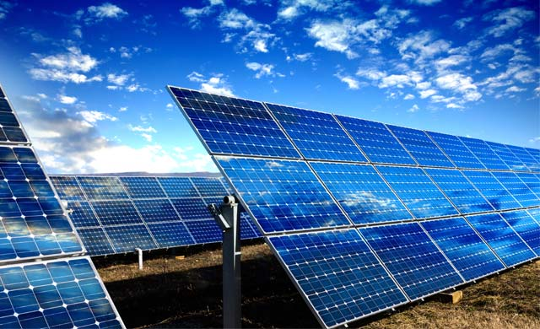

Study the economics of
optimizing solar energy capture and energy storage in a rural setting
E/19/055
L.A. Chathuranga
SUPERVISED BY : Dr. P.B. Boyagoda
Department of Mechanical Engineering
Faculty of Engineering
University of Peradeniya

Slide 2

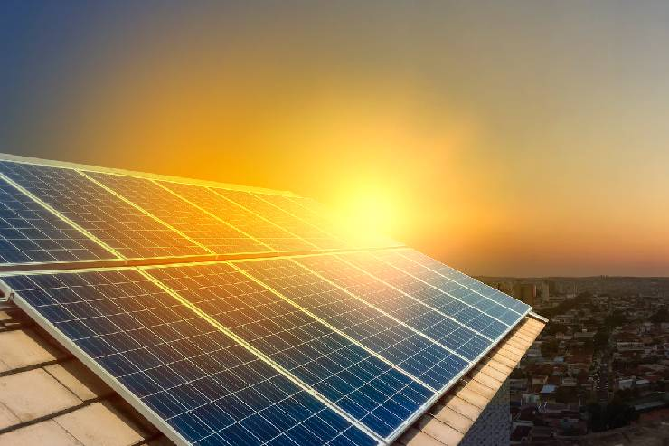
Introduction
This project focuses on a dual-axis solar tracking system to maximize energy capture and a water-based storage method to generate electricity at night, offering a simple and sustainable solution to extend solar energy usage beyond daylight hours.

Slide 3
Problems
1. Daytime Inefficiency: Inefficiencies in solar panel alignment reduce energy capture, limiting the overall potential of solar energy systems.
2. Nighttime Energy Gap: Solar energy production drops significantly at night, creating a reliance on alternative power sources.

Slide 4
Objectives
Design and implement a dual-axis solar tracking system to maximize energy capture.
Use surplus solar energy to pump water to a higher elevation for storage.
Develop a system to utilize stored potential energy at night to generate electricity.

Slide 5

Conceptual Diagram
Solar Panel → Tracking System → Energy Controller
Pump → Elevated Water Storage → Turbine → Energy Generation at Night.

Slide 6

Key Components
Solar tracking (using LDR).
Pumping system for water storage.
Turbine for energy recovery.

Slide 7
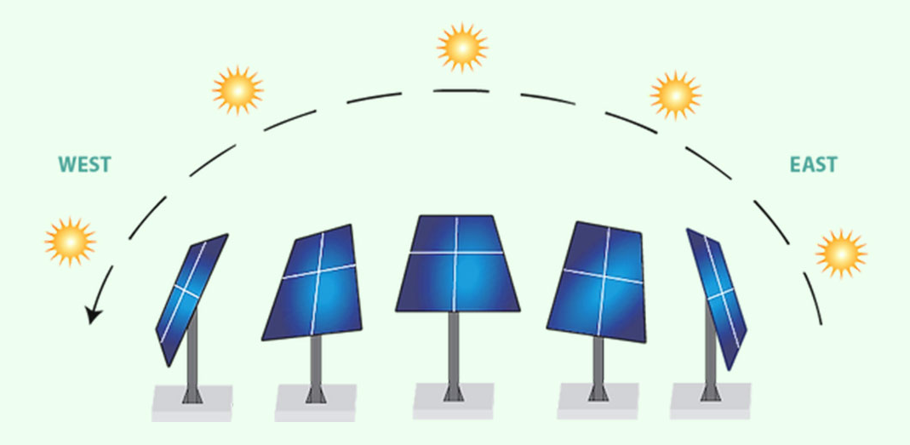
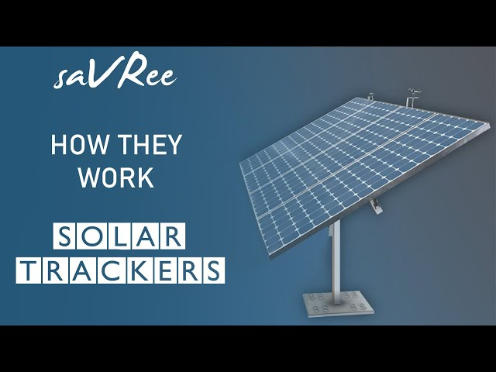
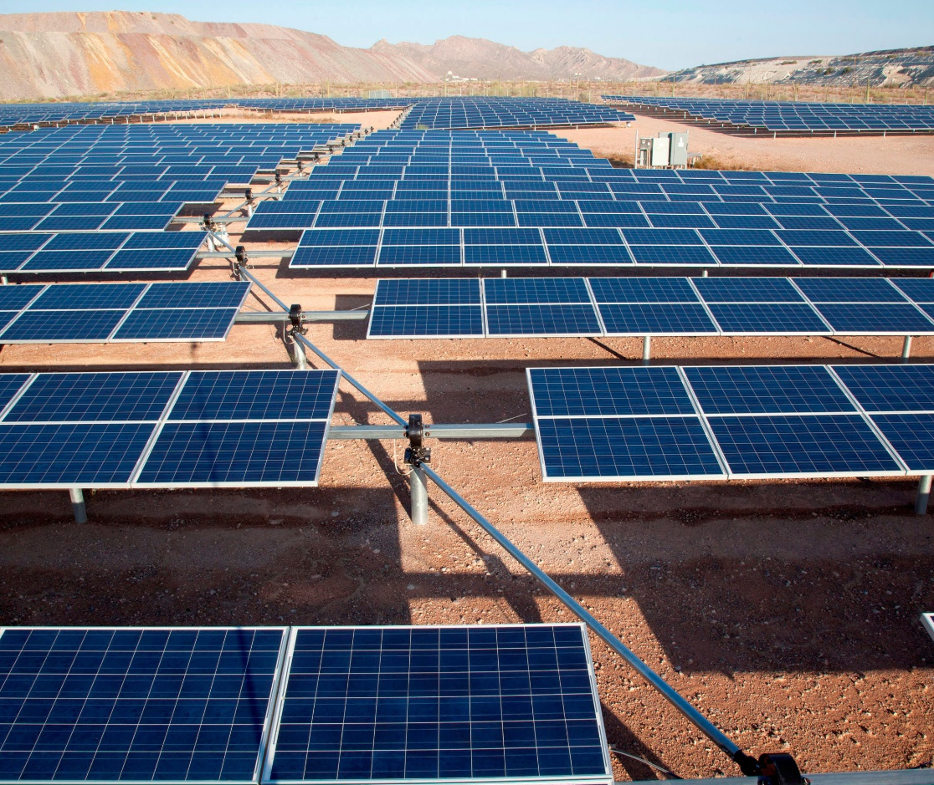
Solar Tracking System
Principle:
Use Light Dependent Resistors (LDRs) to detect sunlight intensity and track the sun's movement.
Mechanics:
Movement along two axes (horizontal and vertical) for optimal alignment with the sun.
Benefits:
Increased energy capture efficiency by aligning panels perpendicularly to sunlight.

Slide 8
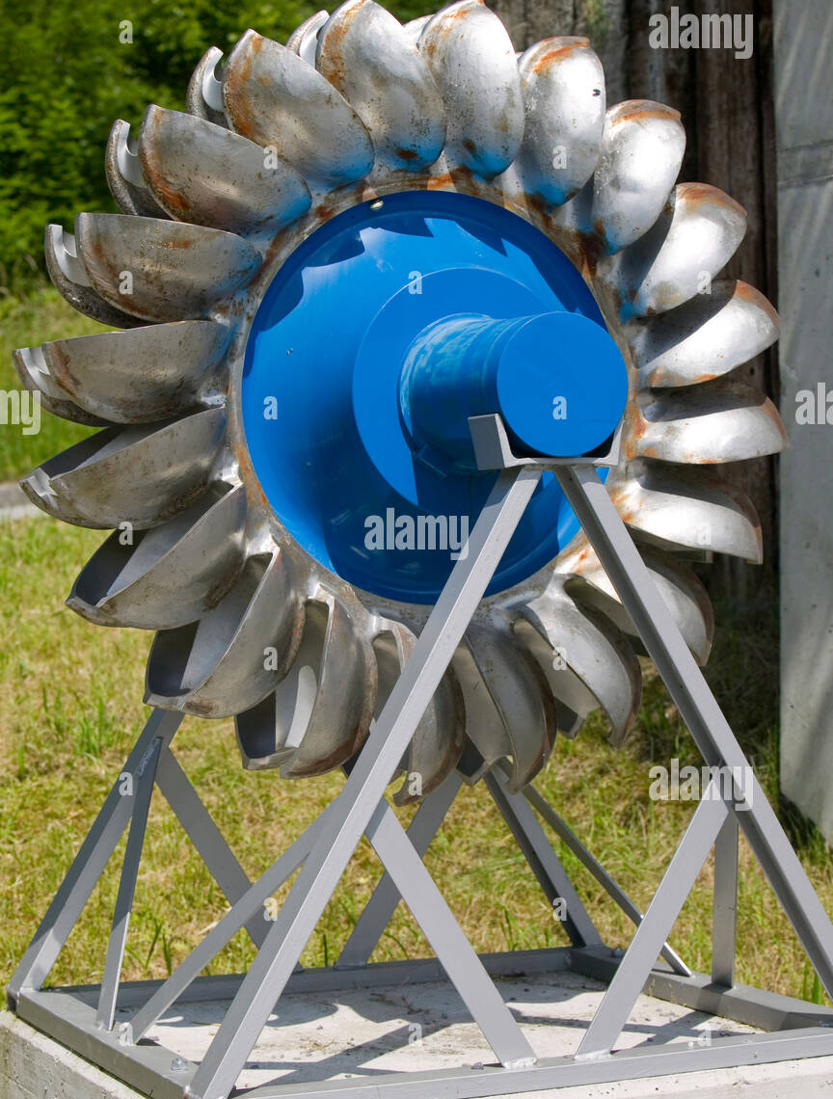
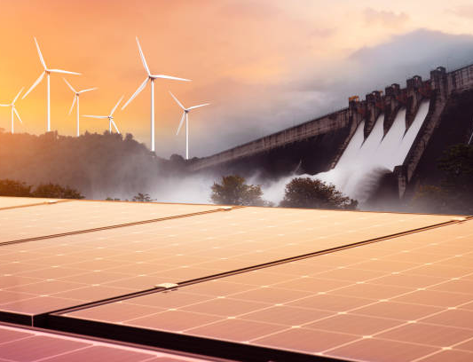
Water-Based Energy Storage
How it Works:
Excess solar energy during peak hours drives a water pump.
Water is stored in an elevated tank.
At night, the water flows down, driving a turbine to generate electricity.
Advantages:
Simple and cost-effective.
Reduces reliance on batteries for energy storage.

Slide 9


Project Challenges
Accurate Sun Tracking: Ensuring precise alignment of the solar panels with the sun’s movement throughout the day.
Energy Storage Efficiency: Developing a reliable and cost-effective method for storing surplus energy and converting it back to electricity at night.
Evacuation Procedures: Evacuation plans and assembly point.
Evacuation Procedures: Evacuation plans and assembly points.
Weather Dependency: Variability in solar energy production due to weather conditions, affecting system performance.

Slide 10

Expected Outcomes
Efficiency Improvements:
Increased solar energy capture using tracking.
Reliable nighttime power generation.
Potential Applications:
Rural and off-grid areas.
Scalable solutions for energy needs in small communities.

Slide 11
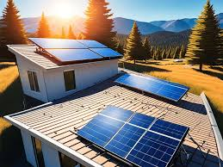
Conclusion
Developed a dual-axis solar tracking system to maximize energy capture during the day.
Designed a water-based energy storage system to generate electricity at night.
Addressed key challenges of solar energy, such as inefficiency and nighttime availability.
Provided a cost-effective and sustainable alternative to conventional energy storage solutions.
Showcased potential for broader application in off-grid and rural areas.

Slide 12
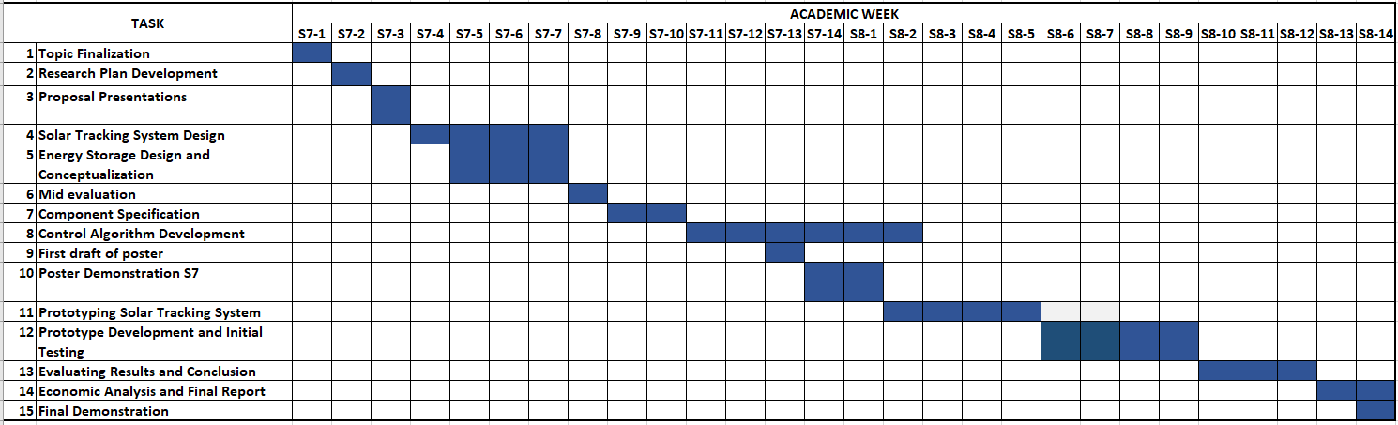
Project Timeline

Slide 13
Q & A

Slide 14

Thank You

